Slide 1
Summary of
2017 Compliance Activity
Billing and Coding-Related Activity
HIPAA/Privacy
EthicsPoint (Compliance Hotline)
Compliance Education

Slide 2
Billing and Coding
2017 Work Plan Results
Key Areas of Focus:
Ongoing Monitoring

Slide 3
Unscheduled Audits/Projects
Increased government focus expected to continue
Agency
Centers for Medicare and Medicaid (CMS)
WPS Government Health Administrators (GHA)
Strategic Health Solutions (ZPIC)
For Cause

Slide 4
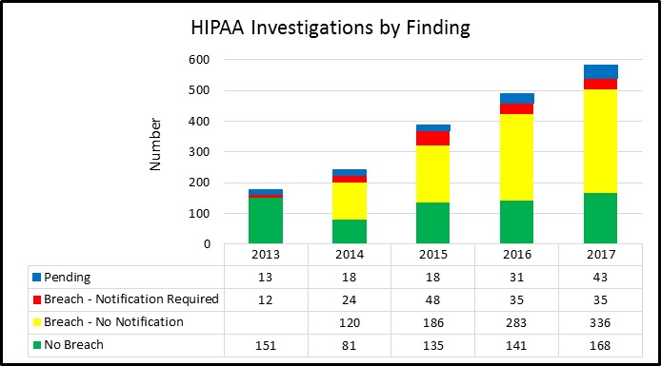
HIPAA Privacy Investigations
Key Focus Areas
Patient identification processes during registration and discharge processes
Implementation of Epic user access audit tools
Review of HIM process controls related to Release of Information
Review of process and controls related to fax number directories
Continued education on process for secure email and exploration of controls within Outlook application

Slide 5
EthicsPoint Numbers 2017
No significant cases reported
Significant cases would include:
Serious law violations
Reputational harm or serious risk
Issues triggering financial restatement
Other serious risk to operations or financial position

Slide 6
EthicsPoint Numbers 2017
Increased volume attributed to:
Increased awareness of hotline; and
Recurring issues from a few specific departments

Slide 7
Corporate Compliance Education
2018 Curriculum
Orientation Materials
New Workforce Course
Annual Workforce Course
Risk Area Webinars
Risk Area Seminars
On Demand Education
2017 Completion: Continue to partner with HSO’s Liaisons and HRBP to ensure completion.

Slide 8
Appendix
2017 Year End Report
External Reviews/Audits
Internal/For Cause Compliance Audits
Stark Self-Disclosures
RAC Activity
HIPAA/Privacy Activity
Provider-Based Activity
Overall Work Plan Summary

